Slide 1

Python Fundamentals (Week 1)
Louis Rey
UCSD Extension

Slide 2
Course Objective
Understand Python advanced programming concepts
Understand Inheritance and Composition
Use the Python standard library modules and third-party libraries
Install Python packages into a project and how to use them
Understand how to interact with files, network applications and data
Learn advanced Python libraries and programming technique

Slide 3
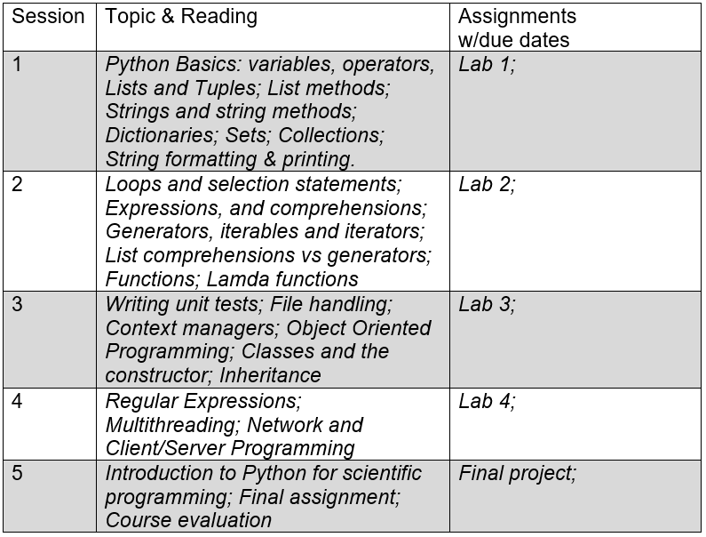
Course Schedule and Content

Slide 4
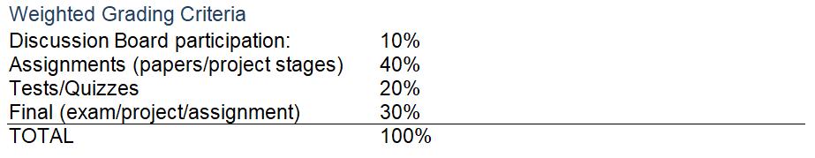
Grading and Coursework

Slide 5
Week 1 Objectives
Python Basics
Variables, operators
Lists and Tuples
List methods
Strings and string methods
Dictionaries
Sets
Collections
String formatting & printing

Slide 6
What is Python
Python is an interpreted, object-oriented, high-level programming language with dynamic semantics.
Its high-level built in data structures, combined with dynamic typing and dynamic binding, make it very attractive for Rapid Application Development, as well as for use as a scripting or glue language to connect existing components together.
Slower than C or Fortran. It is an all-purpose programming language.

Slide 7
What Industries Use Python Today?
Python is used in area such as
- Data Science
- Artificial Intelligence
- Machine Learning
- Computer Vision
- The internet of things (IOT)
- Robotics
- Web design
- Electrical Engineering
- Communications
- Engineering Simulation
- Industrial Automation
- Quantum Computing
- And many more

Slide 8
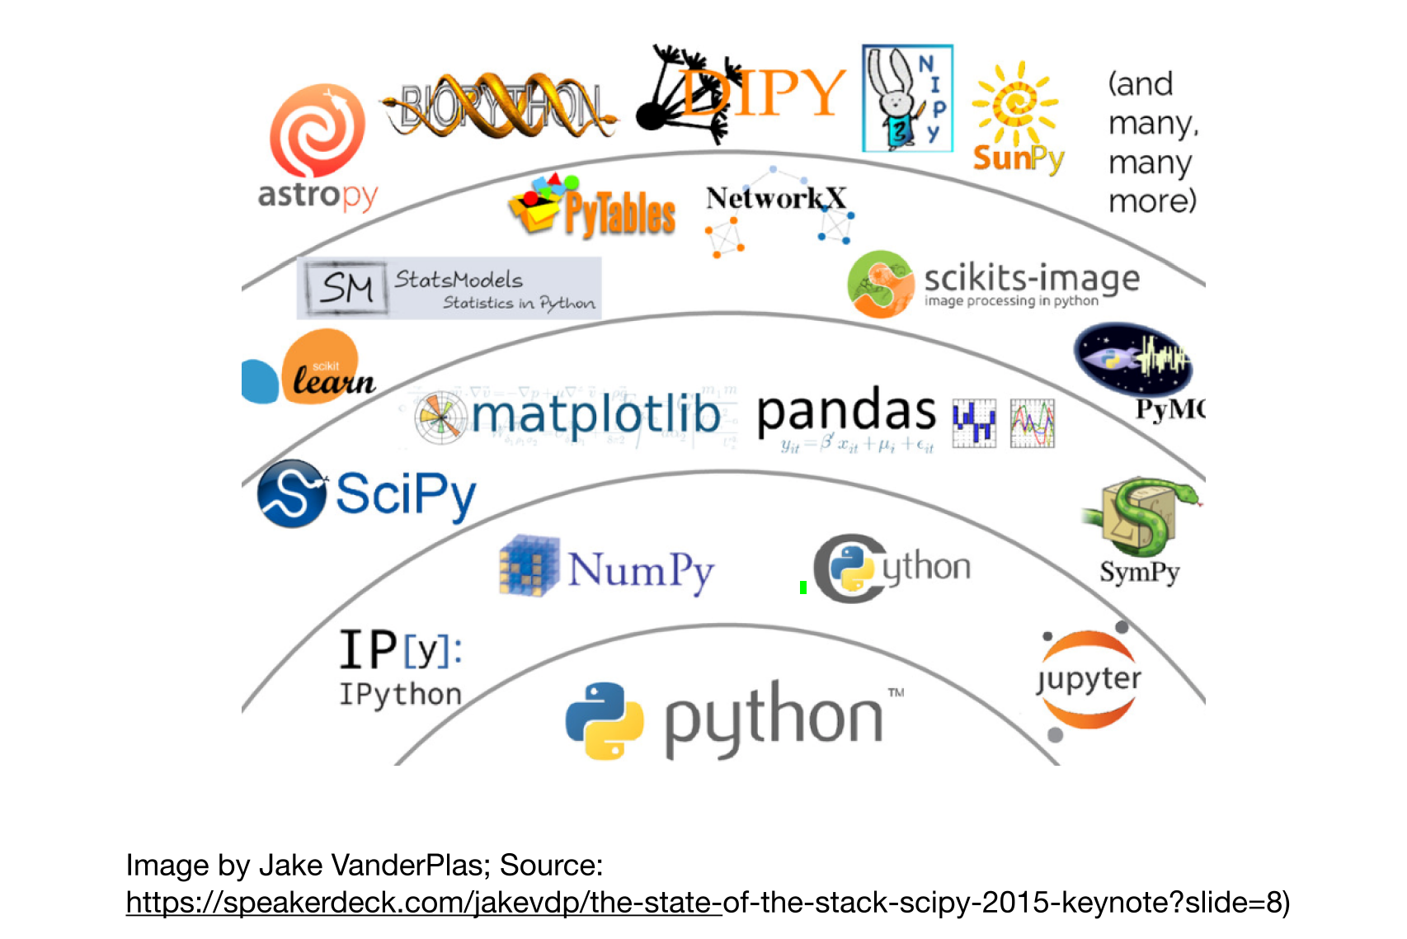

Slide 9
Installing & Running Python

Slide 10
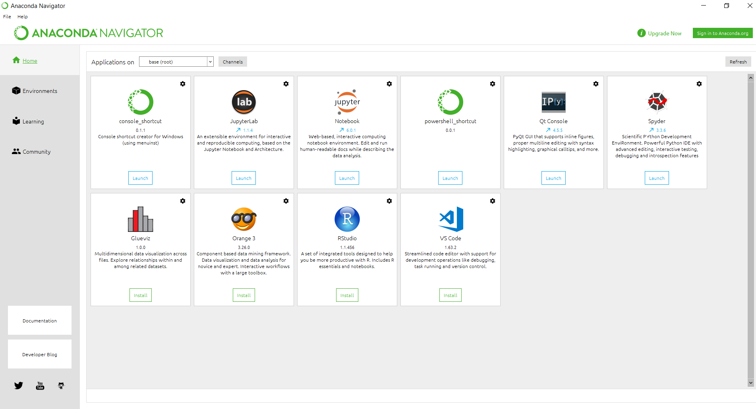
Python Environment
• Anaconda Navigator

Slide 11
Packages Available
List of packages can be found at https://docs.anaconda.com/anaconda/packages/old-pkg-lists/4.3.1/py35/
Notable packages:
Matplotlib
Numpy
Pandas
Spyder
Ipython
Scipy
QT
Pytest
Jupyter (notebook/lab)
Rstudio

Slide 12
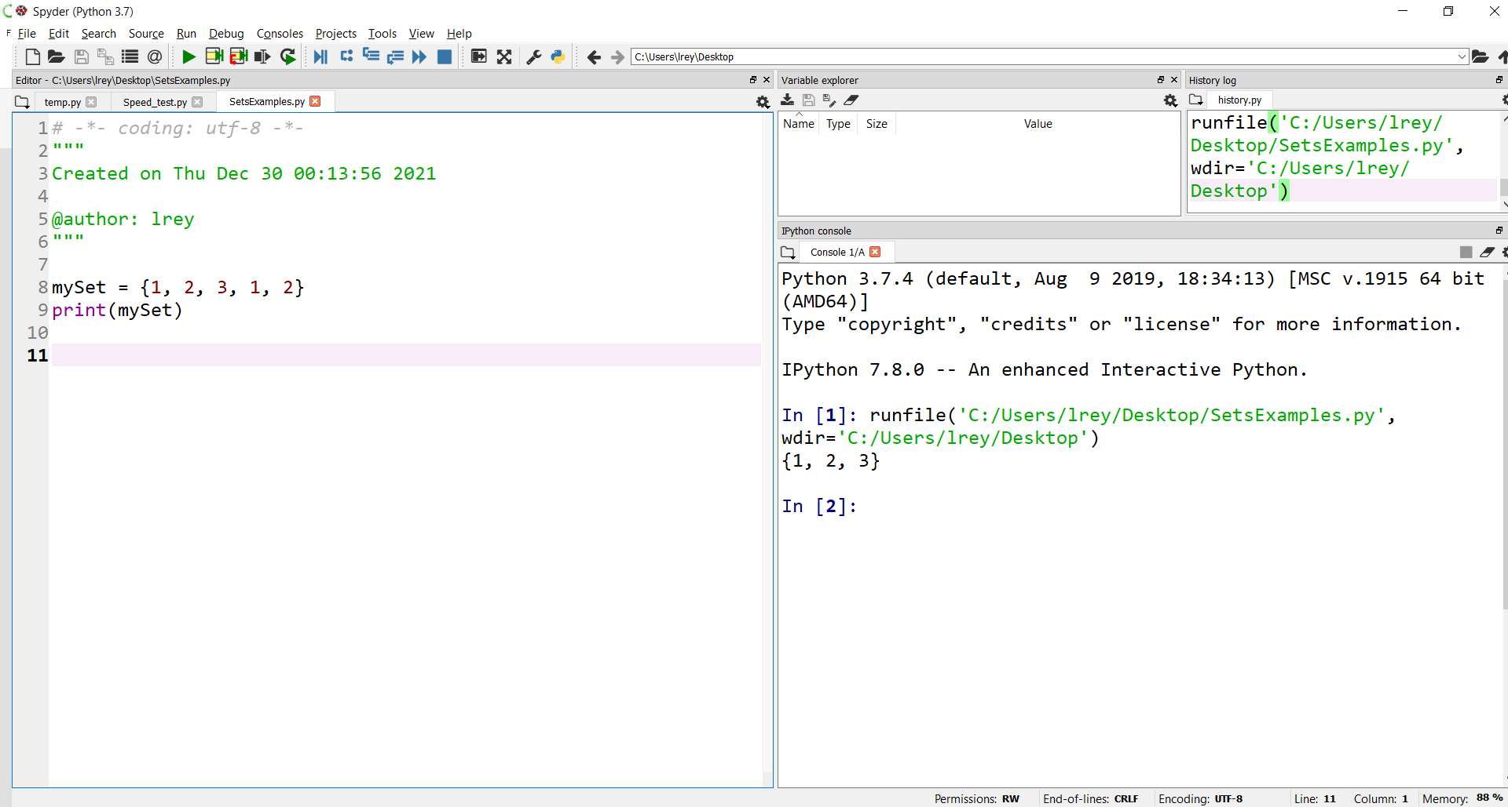
Spyder Environment

Slide 13
numpy
• Offers Matlab-ish (scientific modeling and simulation) capabilities within Python
• Fast array operations
• 2D arrays, multi-D arrays, linear algebra etc.
• Downloads: https: //numpy.org/
• Tutorial: https://numpy.org/doc/stable/

Slide 14
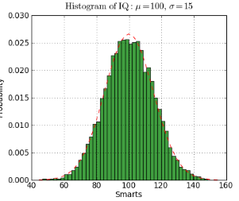
matplotlib
• High quality plotting library.
#!/usr/bin/env python
import numpy as np
import matplotlib.mlab as mlab
import matplotlib.pyplot as plt
mu, sigma = 100, 15
x = mu + sigma*np.random.randn(10000)
# the histogram of the data
n, bins, patches = plt.hist(x, 50, normed=1, facecolor='green',
alpha=0.75)
# add a 'best fit' line
y = mlab.normpdf( bins, mu, sigma)
l = plt.plot(bins, y, 'r--', linewidth=1)
plt.xlabel('Smarts')
plt.ylabel('Probability')
plt.title(r'$\mathrm{Histogram\ of\ IQ:}\ \mu=100,\ \sigma=15$')
plt.axis([40, 160, 0, 0.03])
plt.grid(True)
plt.show()
• Downloads: https://matplotlib.org/

Slide 15
Custom Distributions
• Anaconda Navigator:
https://anaconda.org/anaconda/anaconda-navigator
• Anaconda Navigator is a desktop
graphical user interface included in
Anaconda that allows you to launch
applications and easily manage conda
packages, environments and channels
without the need to use command line
commands
• PyCharm: https://www.jetbrains.com/pycharm/
• PyCharm is designed by programmers,
for programmers, to provide all the tools
you needed for productive Python
development

Slide 16
The Basics

Slide 17
Interactive Help
To enter help topics you will need to type help( ) on the command line
>>> help( )
Once in the interactive help menu you can find more information on any object or function
To exit the help menu simply press CTRL + C or quit on the command line

Slide 18
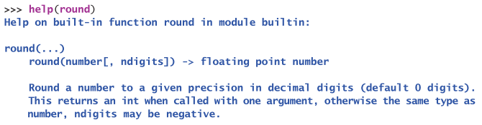
Interactive Help Example

Slide 19
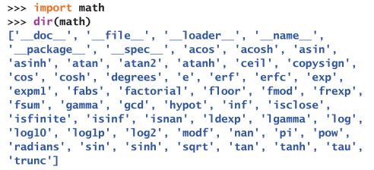
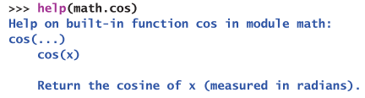
Python Modules

Slide 20
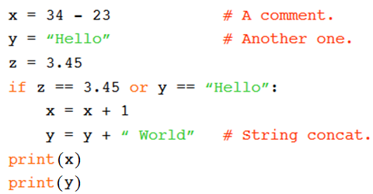
A Code Sample
Note: In Python 2.7.x, the print statement did not require a parenthesis around the element needed to print out
print x

Slide 21
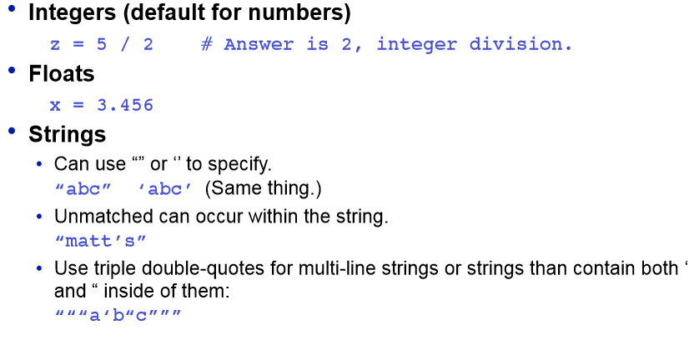
Basic Datatypes

Slide 22
Whitespace
Whitespace is meaningful in Python: especially
indentation and placement of newlines
• Use a newline to end a line of code
• Use \ when must go to next line prematurely
• No braces { } to mark blocks of code in Python…
Use consistent indentation instead
• The first line with less indentation is outside of the block
• The first line with more indentation starts a nested block
• Often a colon appears at the start of a new block (e.g. for function
and class definitions)

Slide 23
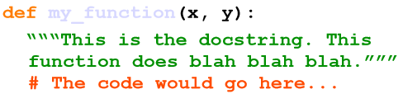
Comments
• Start comments with # – the rest of line is ignored.
• Can include a “documentation string” as the first line of any
new function or class that you define.
• The development environment, debugger, and other tools use it:
it’s good style to include one.

Slide 24
Assignment
• Binding a variable in Python means setting a name to hold a
reference to some object.
• Assignment creates references, not copies
• Names in Python do not have an intrinsic type. Objects have types. • Python determines the type of the reference automatically
based on the data object assigned to it.
• You create a name the first time it appears on the left side of an assignment expression:
>>> x = 3
>>> x=y=3
• A reference is deleted via garbage collection after any names bound
to it have passed out of scope

Slide 25
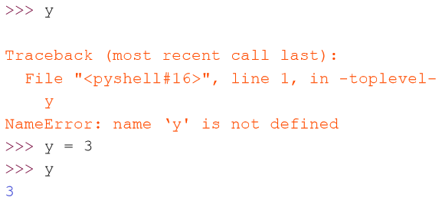
Accessing Non-Existent Names
• If you try to access a name before it’s been properly created (by
placing it on the left side of an assignment), you’ll get an error.

Slide 26
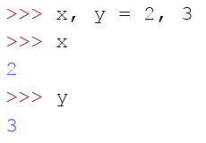
Multiple Assignment
• You can also assign to multiple names at the same time.

Slide 27
Naming Rules
• Names are case sensitive and cannot start with a number.
They can contain letters, numbers, and underscores.
bob Bob _bob _2_bob_ bob_2 BoB
• There are some reserved words:
and, assert, break, class, continue, def, del, elif, else, except, exec, finally, for, from, global, if, import, in, is, lambda, not, or, pass, print, raise, return, try, while

Slide 28
Understanding Reference Semantics in Python

Slide 29
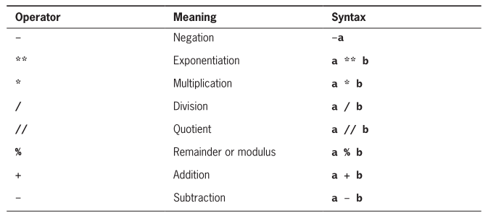
Arithmetic Expressions

Slide 30
Precedence Rules
Exponentials have the highest precedence and is evaluated first
Unary negation is evaluated next, before multiplication, division, and remainder
Multiplication, both types of division, and remainder are evaluated before addition and subtraction
Addition and subtraction are evaluated before assignment
You can use parentheses to change the order of evaluation

Slide 31
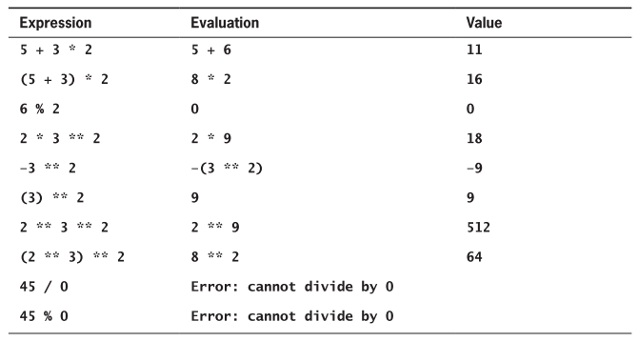
Precedence Rules Examples

Slide 32
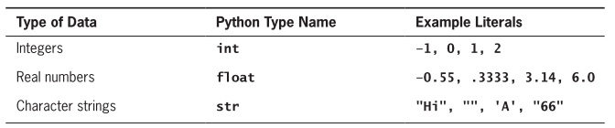
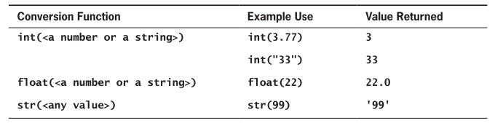
Data Types and Data Type Conversion

Slide 33
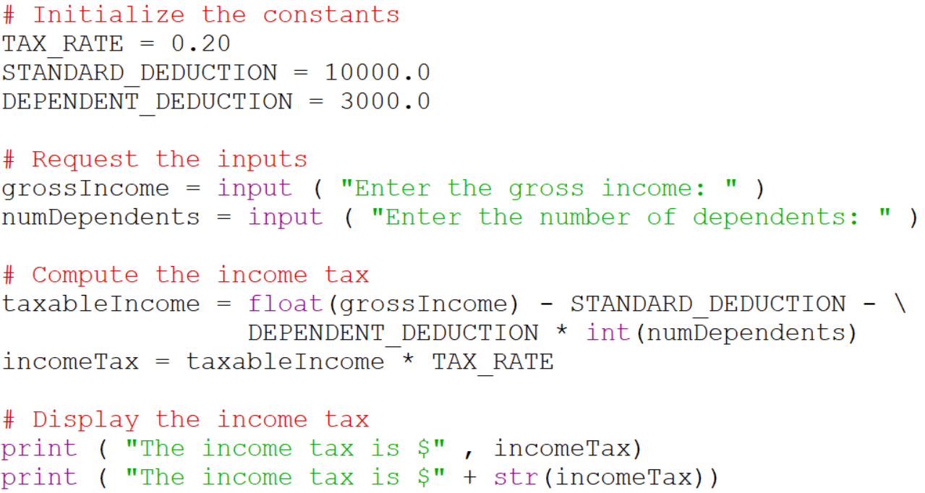
Data Input and Data Conversion Example

Slide 34
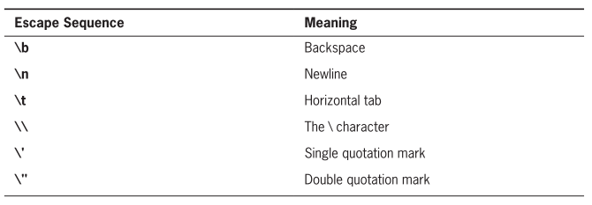
Escape Sequences

Slide 35
Sequence types:
Tuples, Lists, and Strings

Slide 36
Sequence Types
1.Tuple
• A simple immutable ordered sequence of items
• Items can be of mixed types, including collection types
2.Strings
• Immutable
• Conceptually very much like a tuple
3.List
• Mutable ordered sequence of items of mixed types

Slide 37
Similar Syntax
• All three sequence types (tuples, strings, and lists) share much of the
same syntax and functionality.
• Key difference:
• Tuples and strings are immutable
• Lists are mutable
• The operations shown in this section can be applied to all sequence
types
• most examples will just show the operation performed on one

Slide 38
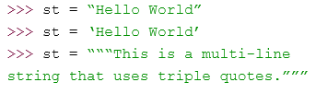
Sequence Types
• Tuples are defined using parentheses (and commas).
• Lists are defined using square brackets (and commas).
• Strings are defined using quotes (“, ‘, or “““).

Slide 39
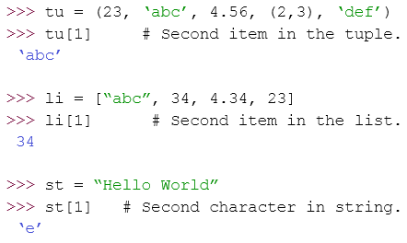
Sequence Types
• We can access individual members of a tuple, list, or string using square
bracket “array” notation.
• Note that all are 0 based…

Slide 40


Positive and negative indices
Positive index: count from the left, starting with 0.
Negative lookup: count from right, starting with –1.

Slide 41


Slicing: Return Copy of a Subset
Return a copy of the container with a subset of the original members. Start copying at the first index, and to stop copying before the second index.
You can also use negative indices when slicing.

Slide 42


Slicing: Return Copy of a Subset
Omit the first index to make a copy starting from the beginning
of the container.
Omit the second index to make a copy starting at the first index
and going to the end of the container.

Slide 43

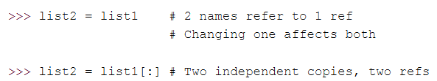
Copying the Whole Sequence
To make a copy of an entire sequence, you can use [:].
Note the difference between these two lines for mutable sequences:

Slide 44
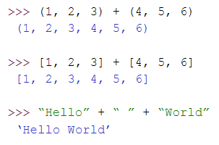
The + Operator
• The + operator produces a new tuple, list, or string whose value is the
concatenation of its arguments.

Slide 45
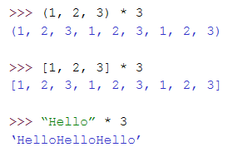
The * Operator
• The * operator produces a new tuple, list, or string that “repeats” the original content.

Slide 46
Mutability:
Tuples vs. Lists

Slide 47
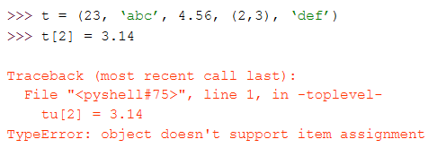
Tuples: Immutable
You can’t change a tuple.
You can make a fresh tuple and assign its reference to a previously used
name.

Slide 48
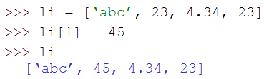
Lists: Mutable
• We can change lists in place.
• Name li still points to the same memory reference when we’re done.
• The mutability of lists means that they aren’t as fast as tuples.

Slide 49
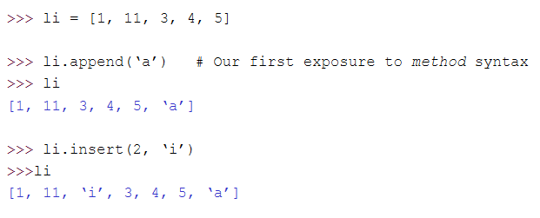
Operations on Lists Only

Slide 50


Operations on Lists Only
• + creates a fresh list (with a new memory reference)
• extend operates on list li in place.
• extend takes a list as an argument.
• append takes a singleton as an argument.

Slide 51
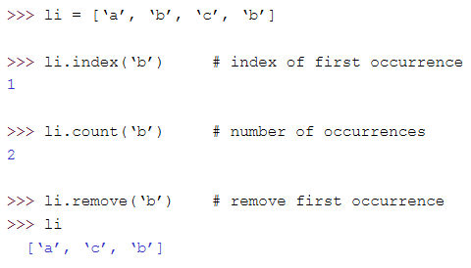
Operations on Lists Only

Slide 52
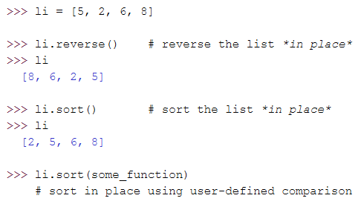
Operations on Lists Only

Slide 53
Tuples vs. Lists
• Lists slower but more powerful than tuples.
• Lists can be modified, and they have lots of handy operations
we can perform on them.
• Tuples are immutable and have fewer features.
• To convert between tuples and lists use the list() and tuple() functions:
li = list(tu)
tu = tuple(li)

Slide 54
String Methods

Slide 55
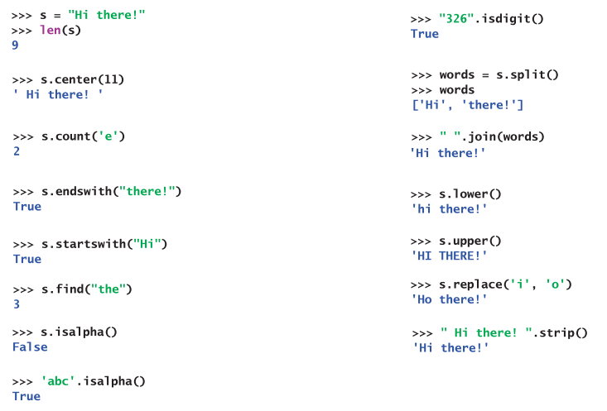
String Methods

Slide 56
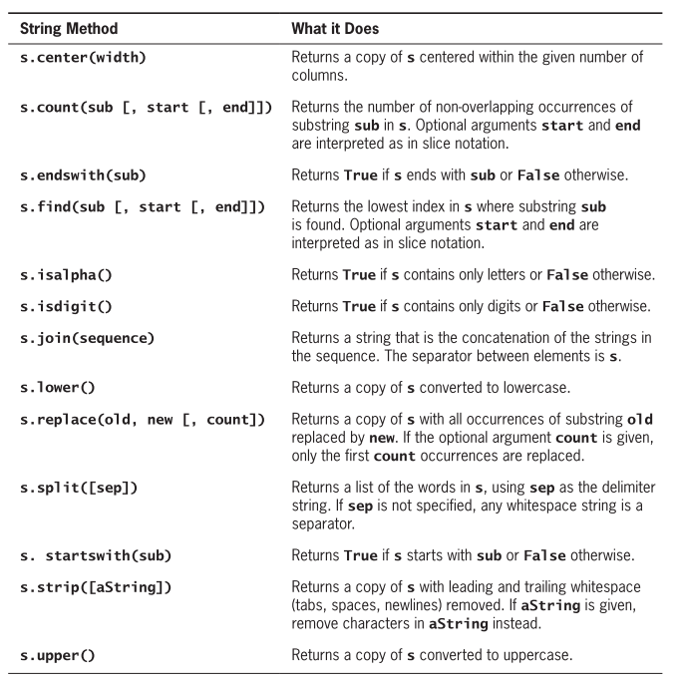
String Methods Summary

Slide 57
Dictionaries

Slide 58
Dictionaries: A Matching Type
• Dictionaries store a mapping between a set of keys and a set of values.
• Keys can be any immutable type.
• Values can be any type
• A single dictionary can store values of different types
• You can define, modify, view, lookup, and delete the key-value pairs in
the dictionary.

Slide 59
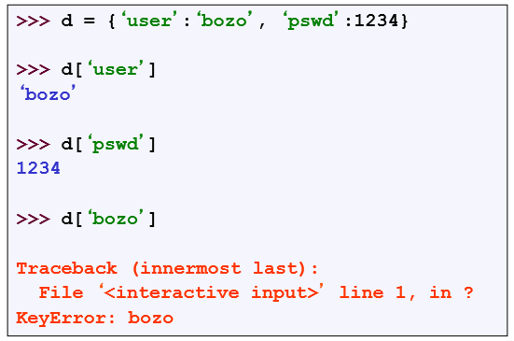
Creating and Accessing Dictionaries

Slide 60
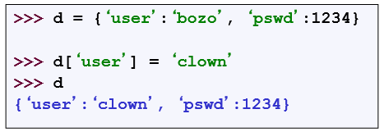
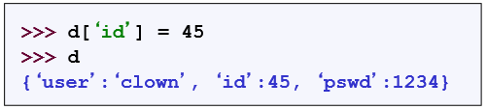
Updating Dictionaries
• Keys must be unique.
• Assigning to an existing key replaces its value.
• Dictionaries are unordered
• New entry might appear anywhere in the output.
• (Dictionaries work by hashing – Associative arrays)

Slide 61
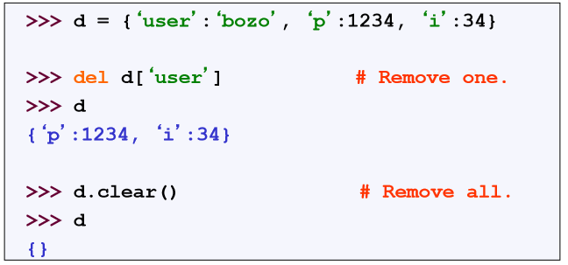
Removing Dictionaries Entries

Slide 62
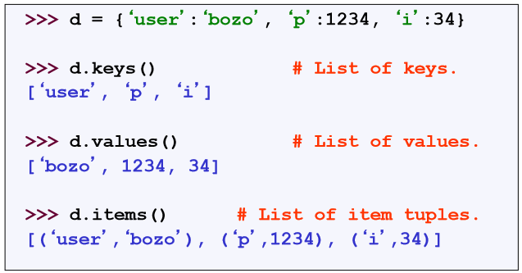
Useful Access Methods

Slide 63
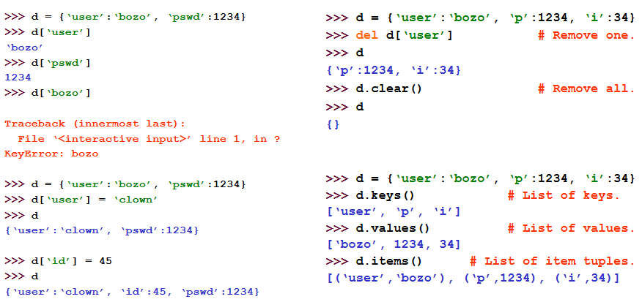
Using Dictionaries

Slide 64
Sets

Slide 65




Set Properties
Unordered, mutable, no duplicates
Uses braces, { }, like dictionaries but with single elements
>>
>>
>>

Slide 66
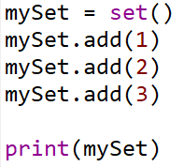



Set Properties
Adding and deleting set elements
>>
>>
>>
>>

Slide 67
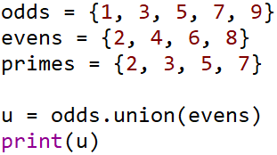

Set Properties
Unions and Intersections
>>
>>

Slide 68
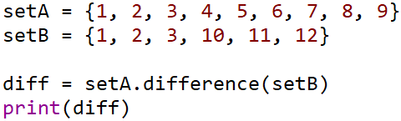


Set Properties
Differences
>>
>>
>>

Slide 69


Set Properties
Immutable set
>>
Copying sets
or

Slide 70
Collections

Slide 71
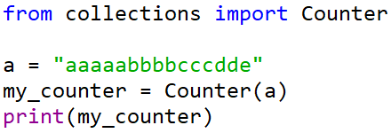

Containers
Special data types
Counter, namedtuple, OrderedDict, defaultdict, deque
>>
>>
>>

Slide 72
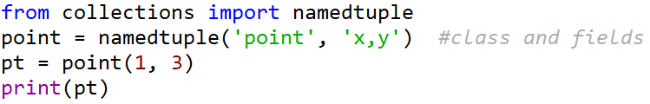
Containers
namedtuple
>>
>>

Slide 73
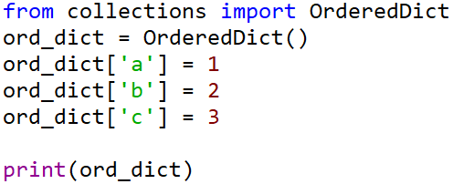
Containers
OrderedDict: Remembers how the items were inserted
>>
>>

Slide 74
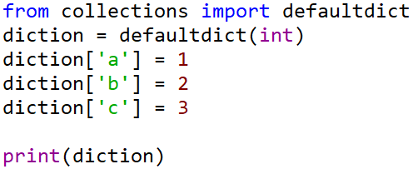
Containers
defaultdict: dictionary class
>>
>>

Slide 75
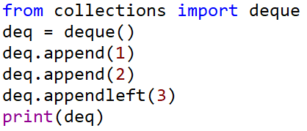




Containers
deque: double ended queue used to add or remove elements from both ends
>>
>>
>>

Slide 76
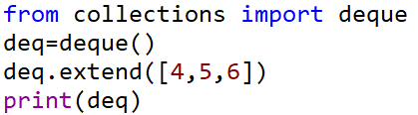



Containers
deque: double ended queue used to add or remove elements from both ends
>>
>>
>>
>>

Slide 77
Basic Formatting

Slide 78
Escape Sequences

Slide 79
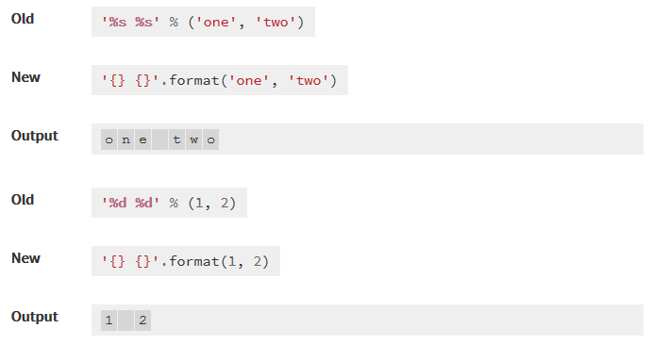
Basic Formatting

Slide 80
Basic Formatting
%s - String (or any object with a string representation, like numbers)
%d – Integers
%f – Floating point numbers
%.<number of digits>f – Floating point numbers with a fixed amount of digits to the right of the dot (e.g. %.2f for monetary presentation)
%x / %X – Integers in hex representation (lowercase/uppercase)

Slide 81
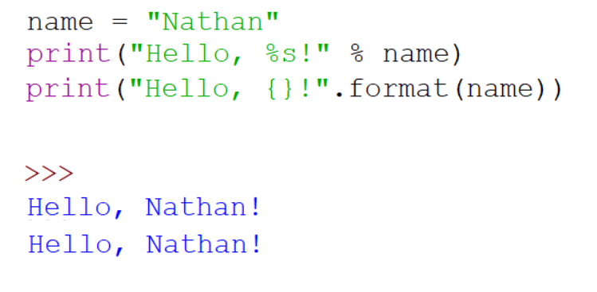
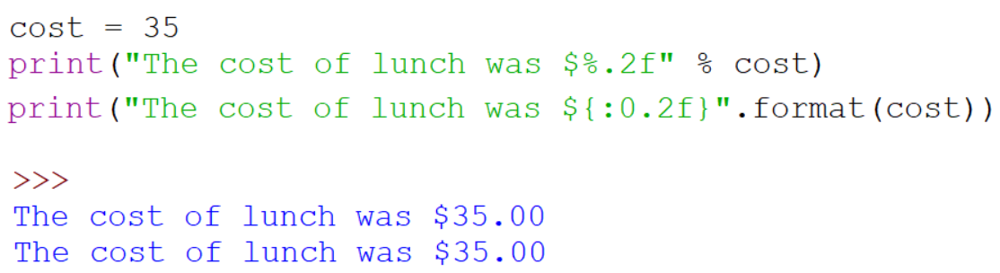
Basic Formatting

Slide 82


Basic Formatting

Slide 83

Basic Formatting

Slide 84
Resources
Matt Huenerfauth (Penn State)
Guido van Rossum (Google)
Richard P. Muller (Caltech)
Bill Boyd (Weslayan University)
Smithsonian Telescope Data Center
Programming Python, Mark Lutz
Fundamentals of Python, Kenneth Lambert

